Slide 1
Chapter Two
Dynamic Programming

Slide 2
Dynamic Programming
Dynamic programming is a technique for solving problems with overlapping sub-problems Typically, these sub problems arise from a recurrence relating a given problem’s solution to solutions of its smaller sub-problems Rather than solving overlapping sub-problems again and again, dynamic programming suggests solving each of the smaller sub-problems only once and recording the results in a table from which a solution to the original problem can then be obtained

Slide 3
Dynamic Programming
DP is primarily used to solve optimization problems and counting problems. If you encounter a problem that says “minimize this” or “maximize that” or “count the ways to do that”, then there is a (high) chance that it is a DP problem.

Slide 4
Fibonacci Sequence
The intuition behind dynamic programming is that we trade space for time.
Fibonacci Sequence is given by the formula.
F (n) = F (n − 1) + F (n − 2) for n >1
F (0) = 0, F(1) = 1

Slide 5
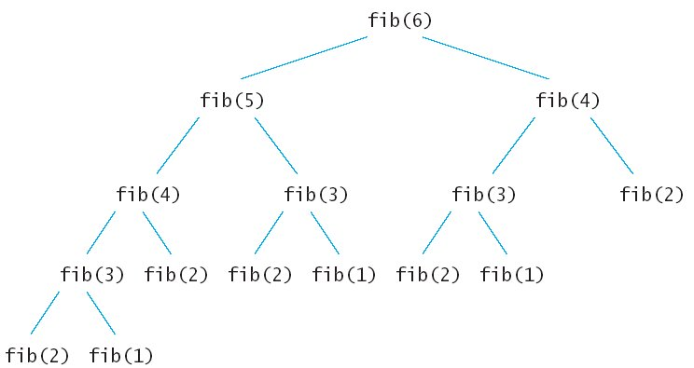
Fibonacci Sequence
The Fibonacci of 6 is calculated recursively as below

Slide 6
Fibonacci Sequence
In the recursive mode, a lot of values are being recalculated multiple times. We could do better with calculating each unique quantity only once. For this we use an array to store a value
So using dynamic programming our solution would look like
int f[m];
f[0] = 0, f[1] = 1
for int i -> 2 to n
f[i] = f[i - 1] + f[i - 2]

Slide 7
Bottom-up vs Top-down
Bottom-up(Tabulation):- As the name indicates it suggests starting from the bottom and accumulating answers to the top.
The bottom-up approach for Fibonacci, we calculate the smaller values of the Fibonacci first, then build larger value from them. This method uses O(n) since it contains a loop that repeats n - 1 times, but it only takes constant O(1) space.
fib_prev1 = 0, fib_prev2 = 1
for i->1 to n
fib_n = fib_prev1 + fib_prev2
fib_prev1 = fib_prev2
fib_prev2 = fib_n
return fib_n

Slide 8
Bottom-up vs Top-down
Top-down(Memorization):- On this approach we first break down the problem into sub-problems then calculate and store values.
function fib(n)
if n == 0
return 0
if n == 1
return 1
if mem[n] == -1
mem[n] = fib(n - 1) + fib(n - 2)
return mem[n];
else
return mem[n]

Slide 9
Example
Given n by m grid you can only move down or to the right and some cells are blocked on the grid, calculate how many paths are there from the top left to the bottom right.
function countPaths(boolean grid[][], int row, int column)
if(!grid[row][column]) return 0
if(row == n || column == m) return 1
return countPaths(grid, row + 1, column) + countPaths(grid, row, column + 1)

Slide 10
Example
Cells with 1 in it are free and you can walk on it. But cells with 0 are blocked.
1 | 1 | 0 | 1 | 1
1 | 1 | 1 | 1 | 1
0 | 1 | 1 | 0 | 1
0 | 1 | 1 | 0 | 1
1 | 1 | 1 | 1 | 1

Slide 11
Example
The time complexit for the above code is O(2^{n*n}). Which is very big.
The problem is the above code is recalculating over and over
For example starting from s the recursion is called in the following order.
The first countPath calculate the path from a and b.
Then a calculates the path from d and c
And b calculates the path from c and e .
Here you can easly see the path from c is calculated twice and as the recursion advances this recompetation grows exponentialy.
s | a | d
b | c
e

Slide 12
Example
So we can eliminate the re-computation by storing on n by n array.
function countPath(boolean grid[][], int row, int col, int path[][])
if(!grid[row][col])
return 0;
if(row == n|| col == m)
return 1;
if(path[row][col] == 0)
path[row][col] = countPath(grid, row + 1, col) + countPath(grid, row, col + 1)
return path[row][col]

Slide 13
Example
Explanation:
The grid on the right is the path counted in each (row, col) cell
1 | 1 | 0 | 1 | 1
1 | 1 | 1 | 1 | 1
0 | 1 | 1 | 0 | 1
0 | 1 | 1 | 0 | 1
1 | 1 | 1 | 1 | 1
0 | 0 | 0 | 0 | 0
0 | 0 | 0 | 0 | 0
0 | 0 | 0 | 0 | 0
0 | 0 | 0 | 0 | 1
0 | 0 | 0 | 1 | 0

Slide 14
Example
Explanation:
The grid on the right is the path counted in each (row, col) cell
1 | 1 | 0 | 1 | 1
1 | 1 | 1 | 1 | 1
0 | 1 | 1 | 0 | 1
0 | 1 | 1 | 0 | 1
1 | 1 | 1 | 1 | 1
0 | 0 | 0 | 0 | 0
0 | 0 | 0 | 0 | 0
0 | 0 | 0 | 0 | 1
0 | 0 | 0 | 0 | 1
0 | 0 | 1 | 1 | 0

Slide 15
Example
Explanation:
The grid on the right is the path counted in each (row, col) cell
1 | 1 | 0 | 1 | 1
1 | 1 | 1 | 1 | 1
0 | 1 | 1 | 0 | 1
0 | 1 | 1 | 0 | 1
1 | 1 | 1 | 1 | 1
0 | 0 | 0 | 0 | 0
0 | 0 | 0 | 0 | 1
0 | 0 | 0 | 0 | 1
0 | 0 | 1 | 0 | 1
0 | 1 | 1 | 1 | 0

Slide 16
Example
Explanation:
The grid on the right is the path counted in each (row, col) cell
1 | 1 | 0 | 1 | 1
1 | 1 | 1 | 1 | 1
0 | 1 | 1 | 0 | 1
0 | 1 | 1 | 0 | 1
1 | 1 | 1 | 1 | 1
0 | 0 | 0 | 0 | 1
0 | 0 | 0 | 1 | 1
0 | 0 | 1 | 0 | 1
0 | 2 | 1 | 0 | 1
1 | 1 | 1 | 1 | 0

Slide 17
Example
Explanation:
The grid on the right is the path counted in each (row, col) cell
1 | 1 | 0 | 1 | 1
1 | 1 | 1 | 1 | 1
0 | 1 | 1 | 0 | 1
0 | 1 | 1 | 0 | 1
1 | 1 | 1 | 1 | 1
0 | 0 | 0 | 2 | 1
0 | 0 | 2 | 1 | 1
0 | 3 | 1 | 0 | 1
0 | 2 | 1 | 0 | 1
1 | 1 | 1 | 1 | 0

Slide 18
Example
Explanation:
The grid on the right is the path counted in each (row, col) cell
1 | 1 | 0 | 1 | 1
1 | 1 | 1 | 1 | 1
0 | 1 | 1 | 0 | 1
0 | 1 | 1 | 0 | 1
1 | 1 | 1 | 1 | 1
0 | 5 | 0 | 2 | 1
5 | 5 | 2 | 1 | 1
0 | 3 | 1 | 0 | 1
0 | 2 | 1 | 0 | 1
1 | 1 | 1 | 1 | 0

Slide 19
Example
Explanation:
The grid on the right is the path counted in each (row, col) cell
1 | 1 | 0 | 1 | 1
1 | 1 | 1 | 1 | 1
0 | 1 | 1 | 0 | 1
0 | 1 | 1 | 0 | 1
1 | 1 | 1 | 1 | 1
10 | 5 | 0 | 2 | 1
5 | 5 | 2 | 1 | 1
0 | 3 | 1 | 0 | 1
0 | 2 | 1 | 0 | 1
1 | 1 | 1 | 1 | 0

